Slide 1
Severe Amazon Droughts and Teleconnections to Atlantic Hurricanes
Brazil-MIT Summit
April 14-15, 2011
Cambridge, MA
Earle Williams
Parsons Laboratory
MIT

Slide 2
Outline
The severe Amazon drought of 1926
Visit to Manaus, Brazil in November 2010; witness to a recent drought
Other severe droughts and evidence for their linkage with Atlantic hurricanes

Slide 3
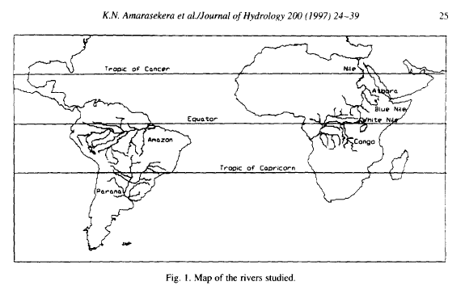
Giant Raingages in Tropical Continental Zones

Slide 4
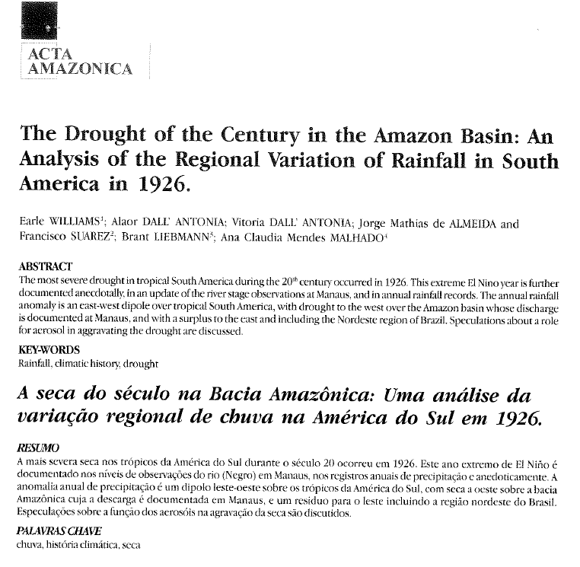
Study of the 1926 Amazon drought (2005)

Slide 5
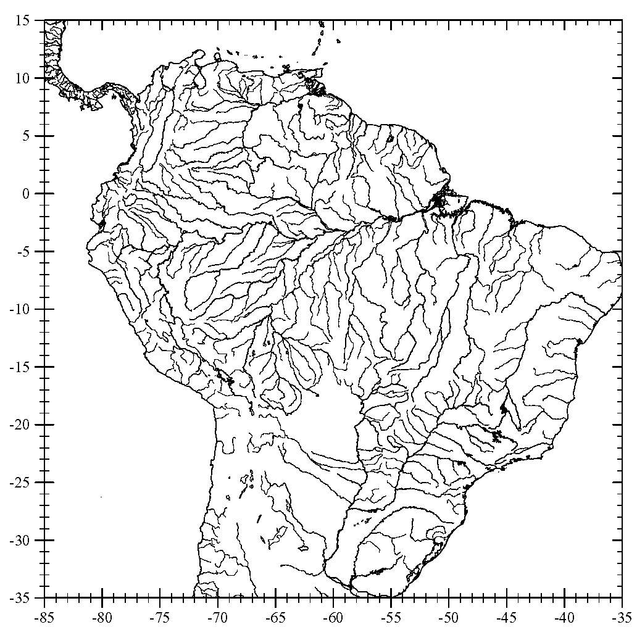
The Amazon Basin and Sub-Basin Drained at Manaus
Manaus
361678_P_22Y.ppt

Slide 6
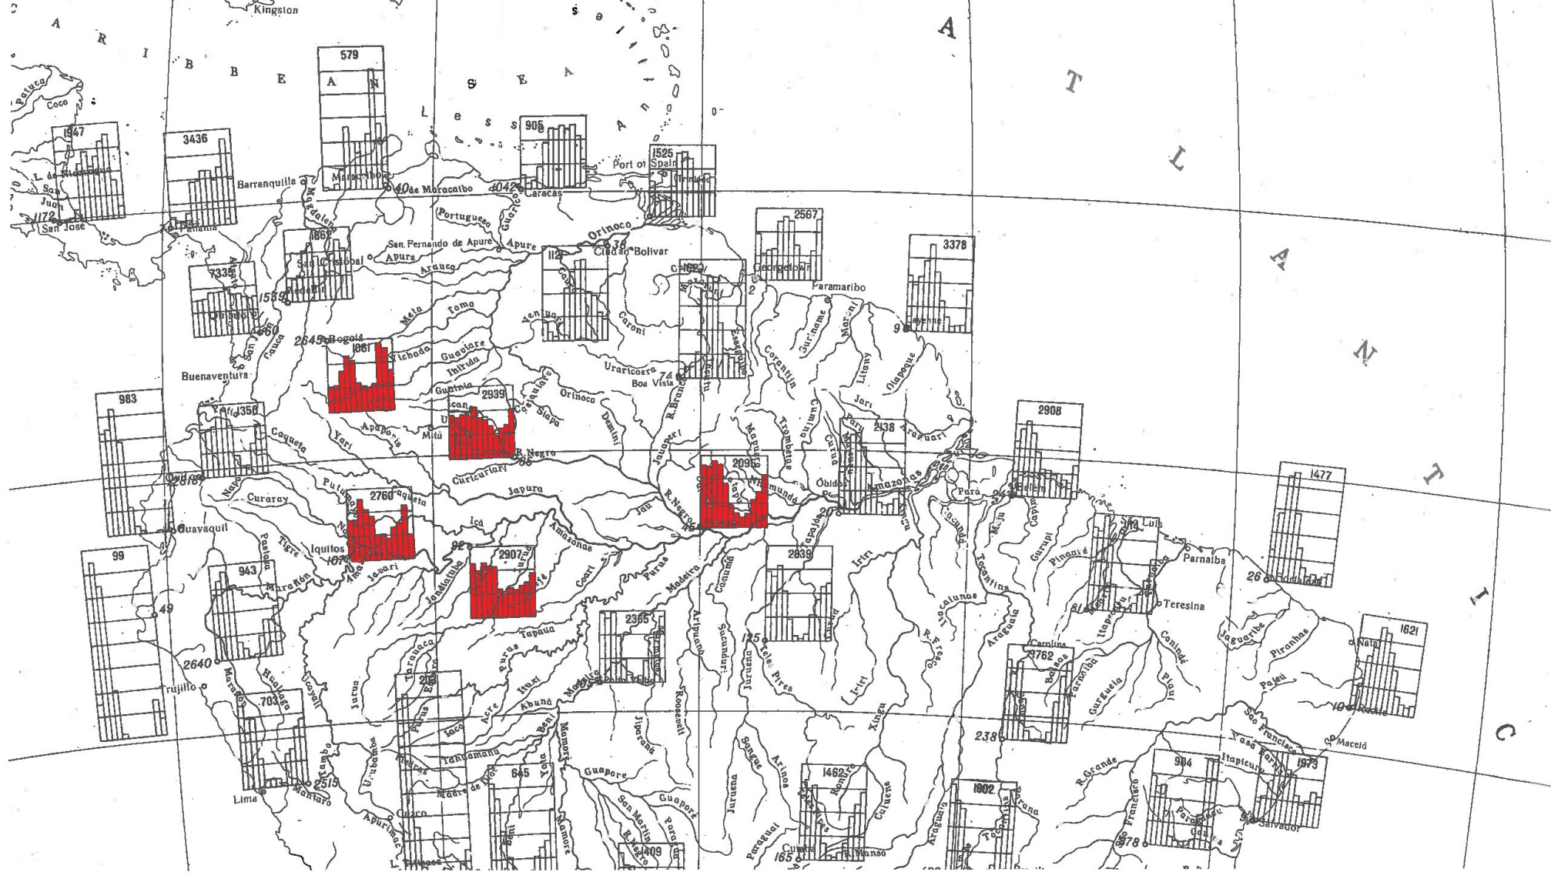
Seasonal phase of rainfall in the Amazon basin
MANAUS

Slide 7
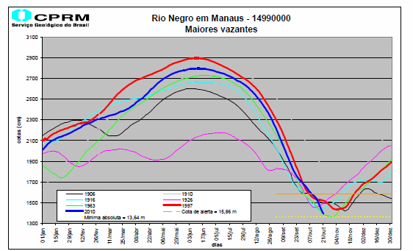
Hydrographs at Manaus for selected years
Rio Negro em Manaus
Maiores vazantes
from ANA and CPRM, Brazil

Slide 8
Record of annual high water marks in Manaus Harbor (1903-2010)
from ANA and CPRM, Brazil

Slide 9
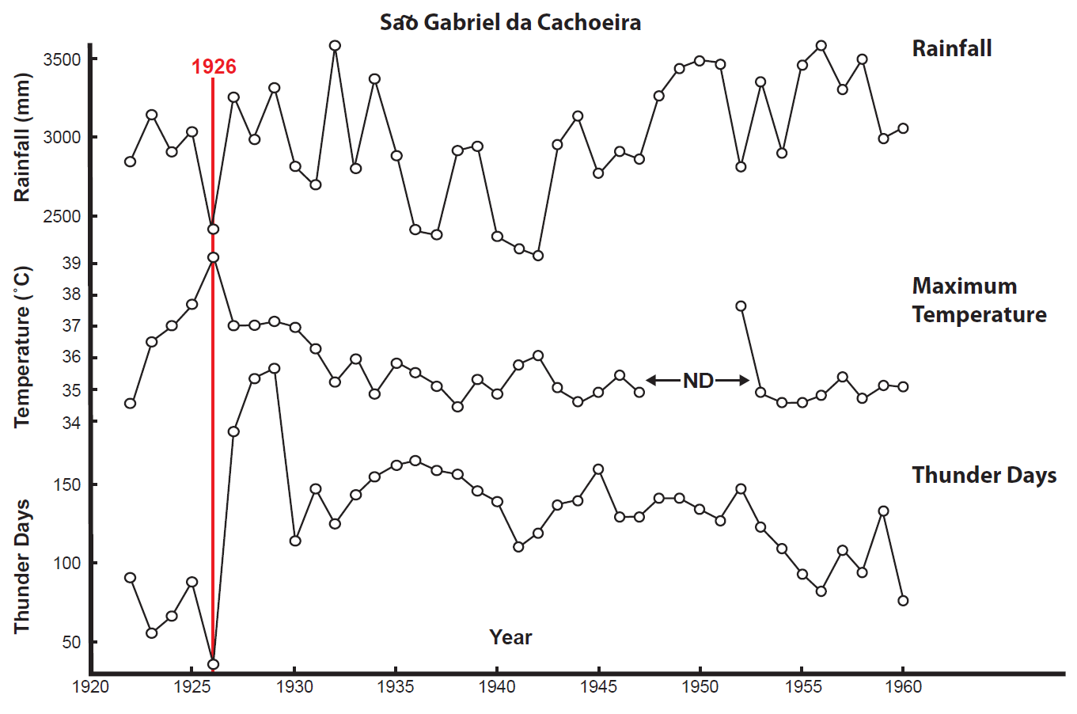
Anomalies in 1926 at station Sao Gabriel da Cachoeira

Slide 10
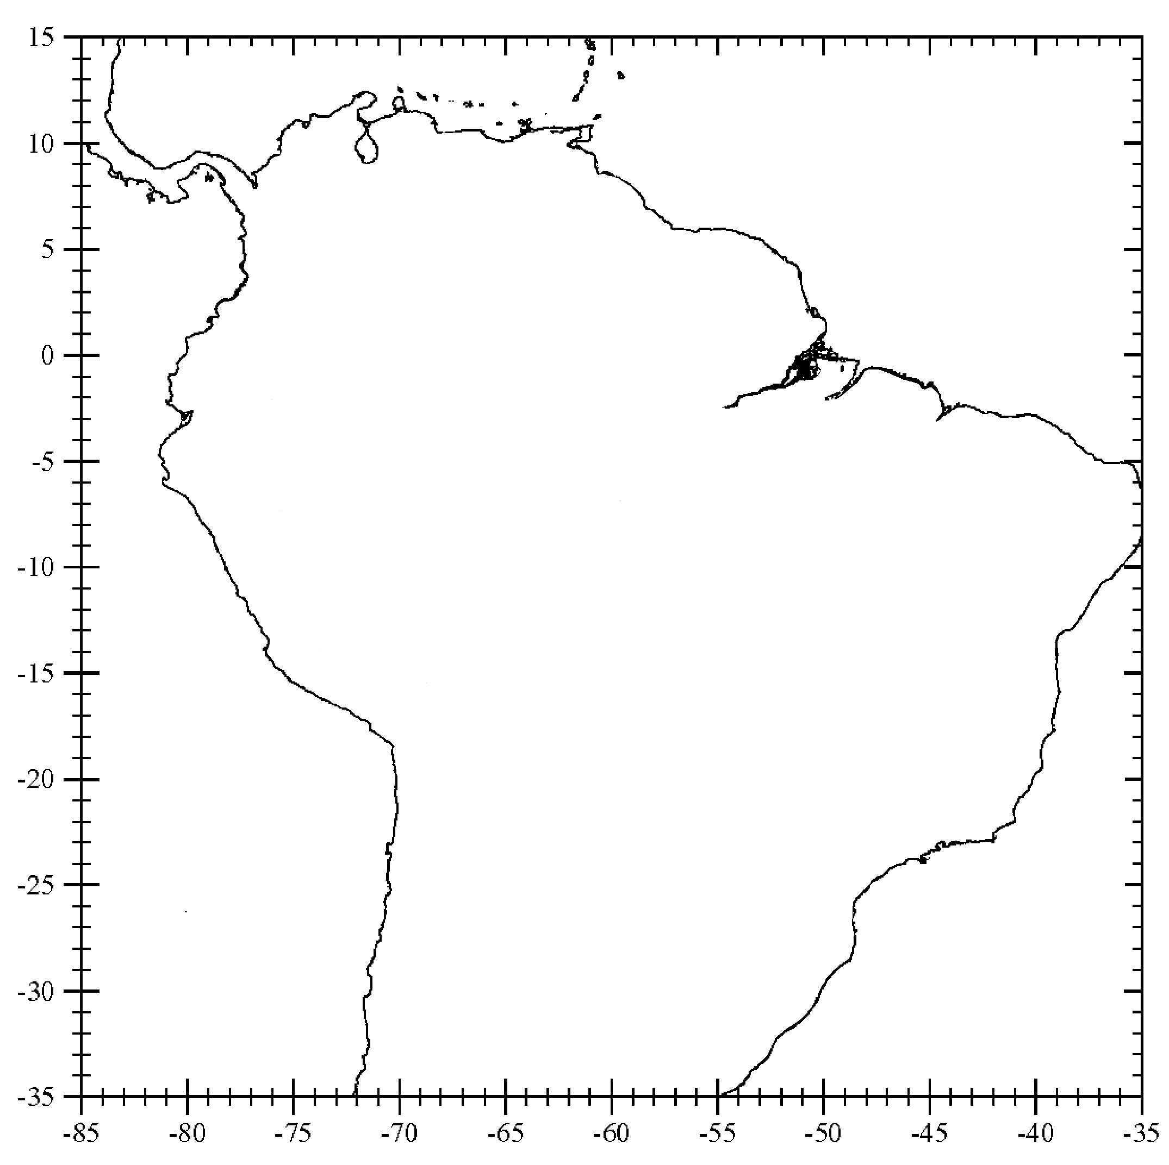
Rainfall Anomaly
Summary for 1926
–31%
–10%
–30%
–18%
–42%
–24%
+23%
Manaus
–15%
+13%
–10%
+17%
+25%
+9%
–5%
Amazon
Basin
361678_P_23Y.ppt

Slide 11
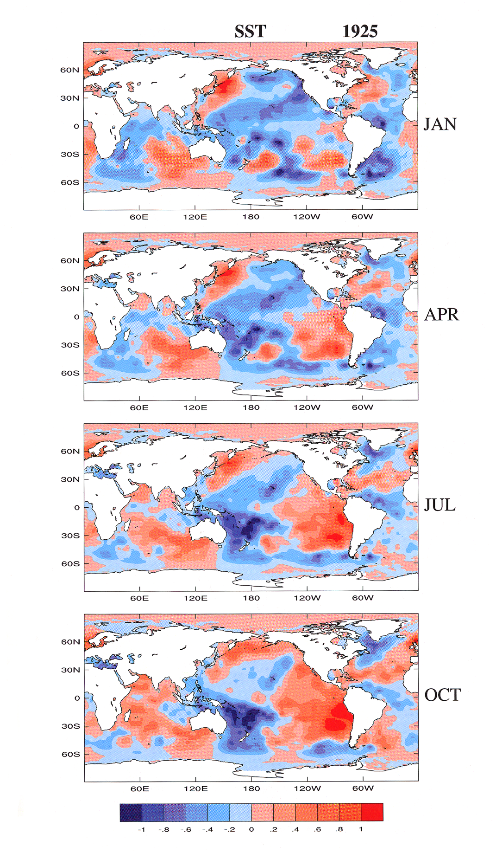
Sea Surface Temperature Anomaly 1925 (from Allan et al. (1996))
361678_P_17Y.ppt

Slide 12
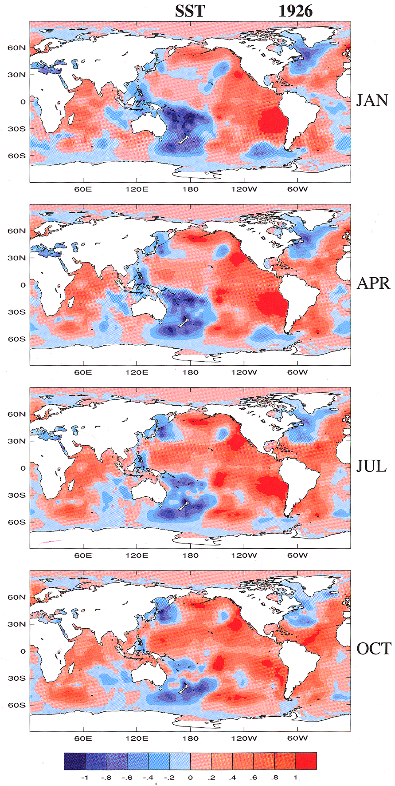
Sea Surface Temperature Anomaly 1926 (from Allan et al. (1996))
361678_P_19Y.ppt

Slide 13
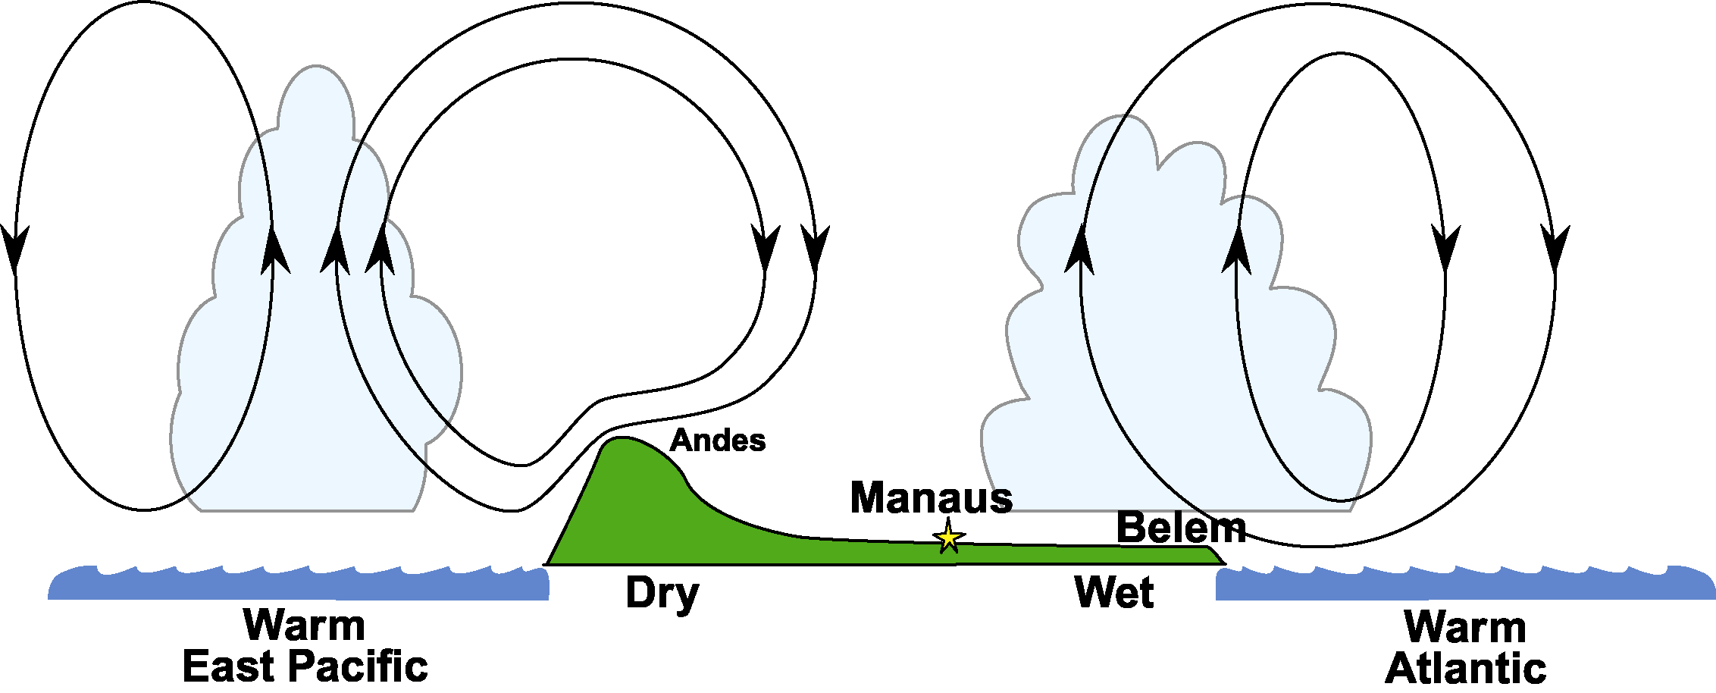
East – West Cross Section
For Drought Year 1926
361678_P_28Y.ppt
Williams 06-18-02
361678_P_28Y.ppt

Slide 14
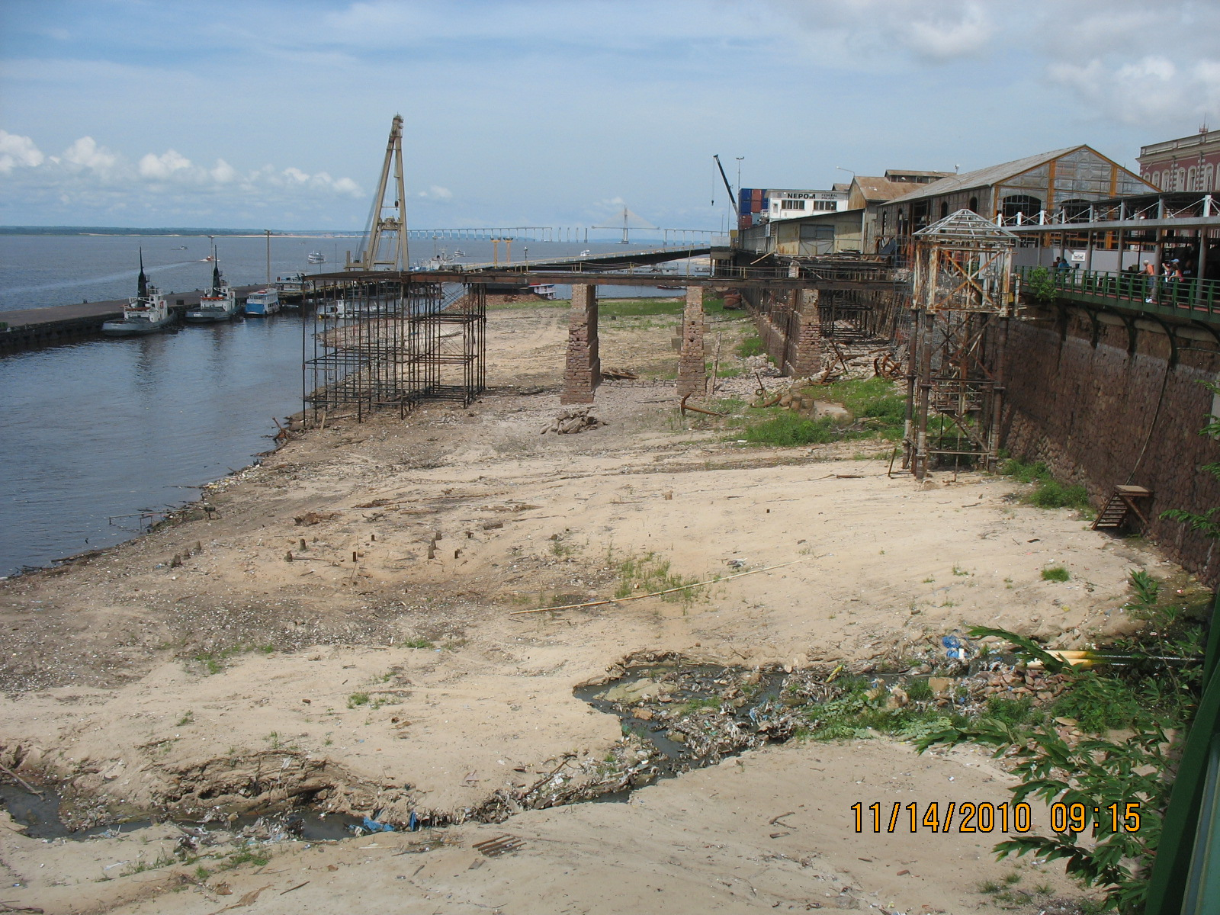
Manaus Harbor, November, 2010

Slide 15
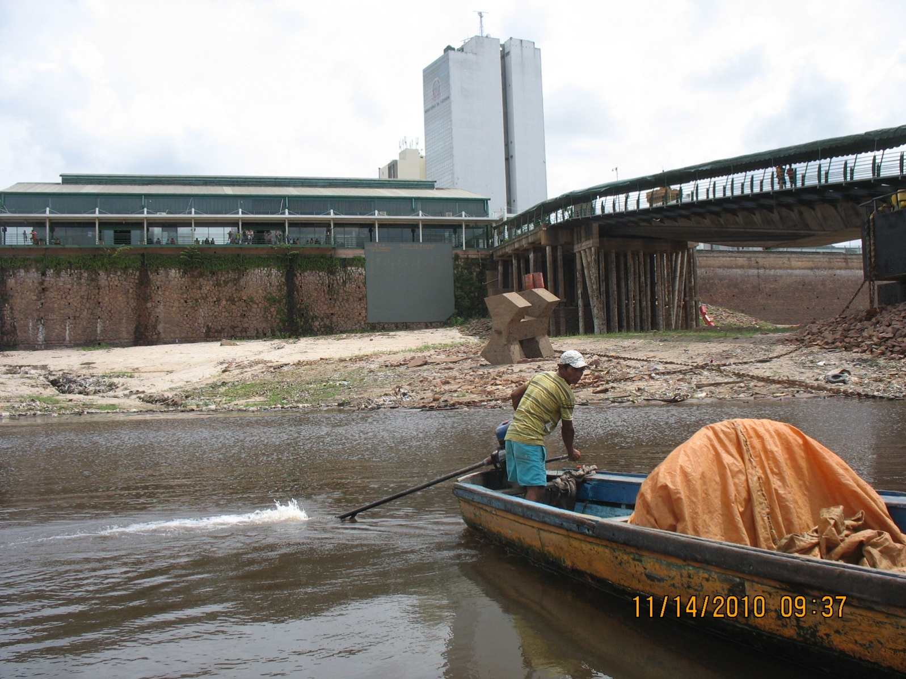
Amazon River at Manaus, Brazil (November 2010)

Slide 16
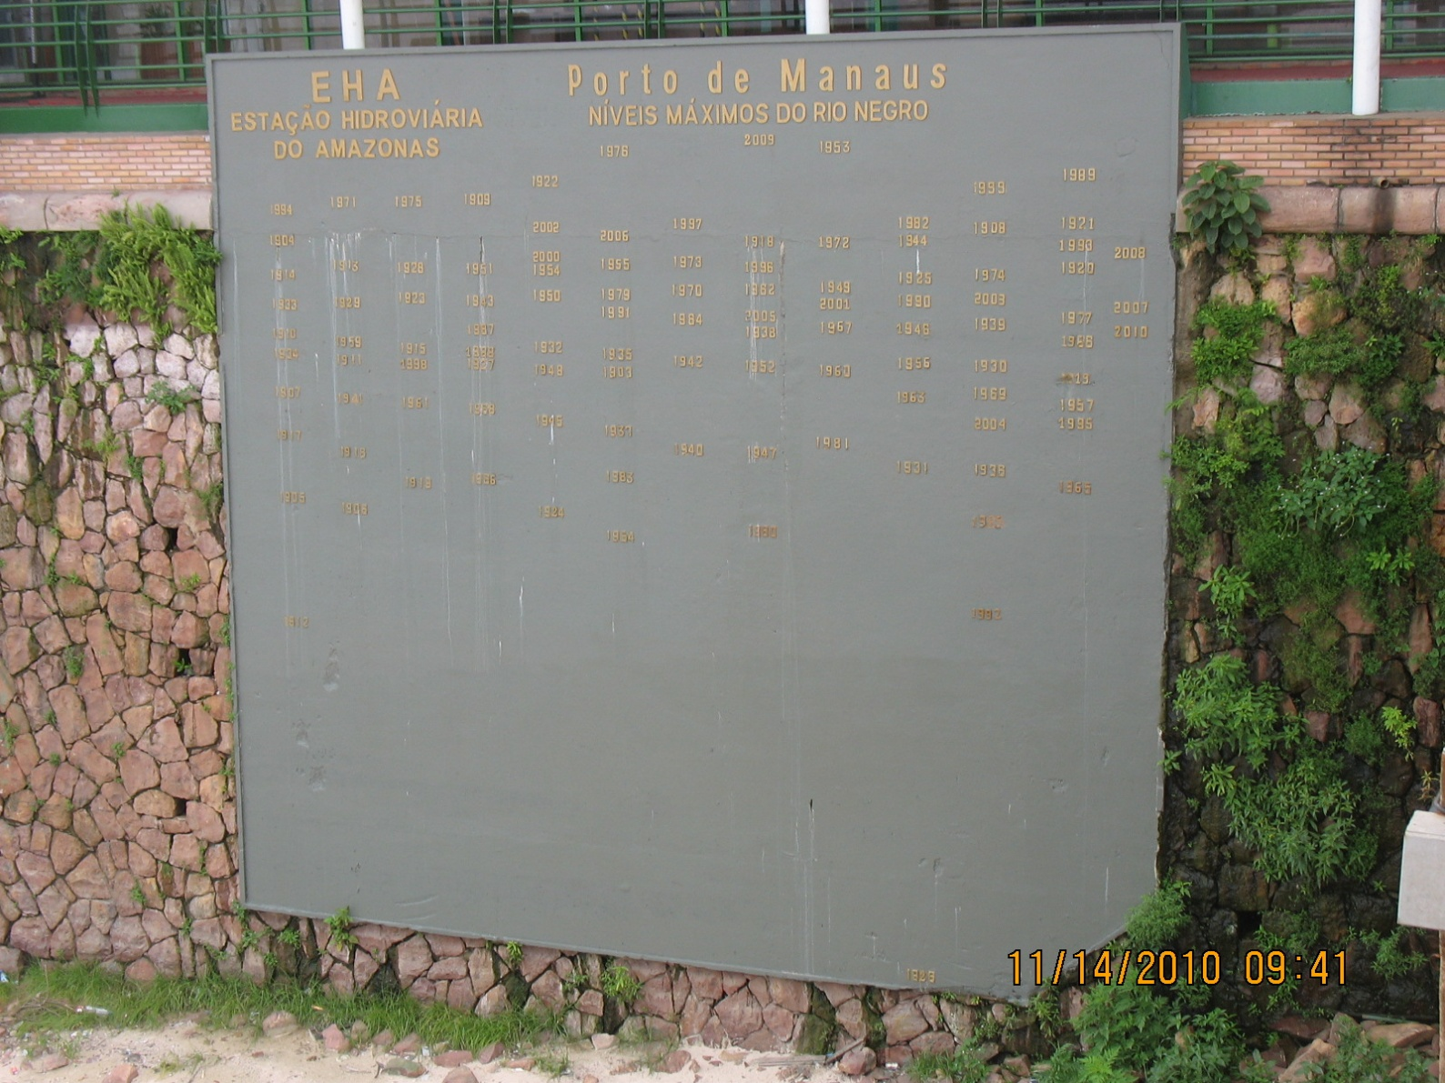
River Gauge at Manaus, Brazil (November, 2010)

Slide 17
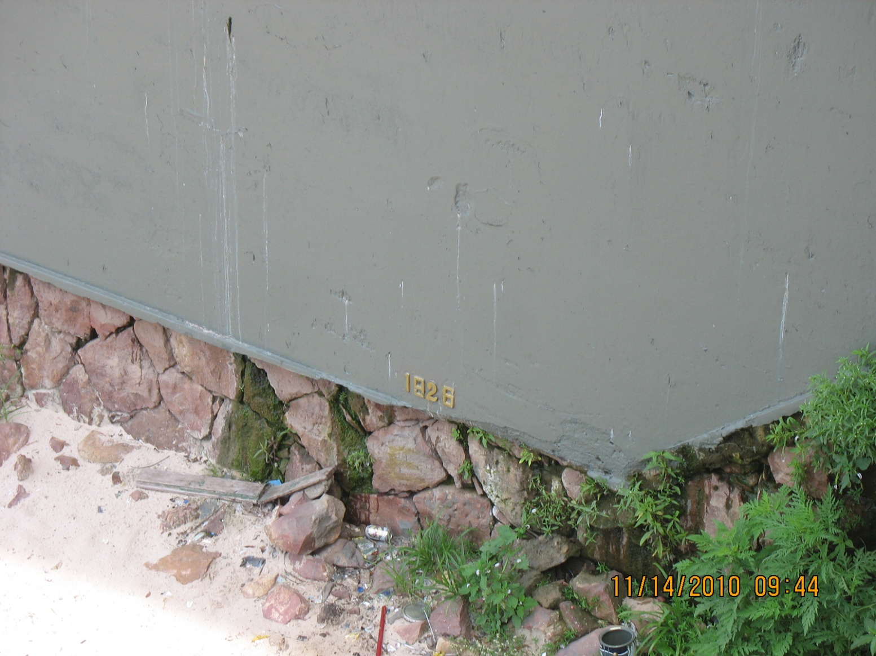
The lowest portion of Amazon River gauge with 1926 record water mark

Slide 18
High and low water marks in Manaus (1903-2010)
New
Record
2010
from ANA and CPRM, Brazil

Slide 19
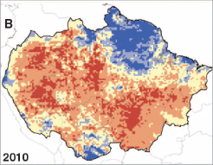
Rainfall anomaly for the dry season (Jul, Aug, Sep) of 2010
from Lewis et al. (2011)

Slide 20
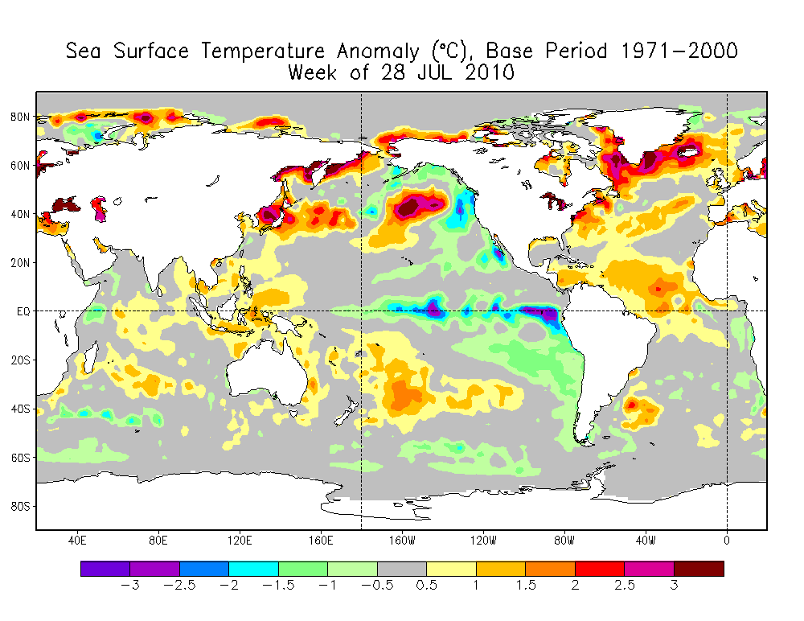
Sea Surface Temperature Anomaly for 28 July 2010

Slide 21
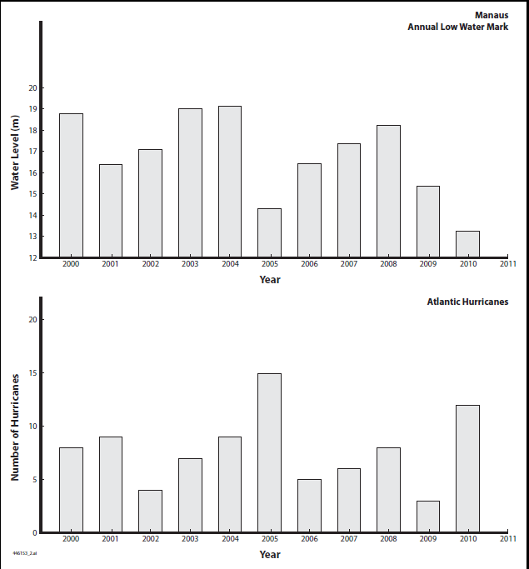
Amazon droughts and Atlantic hurricanes (2000s)

Slide 22
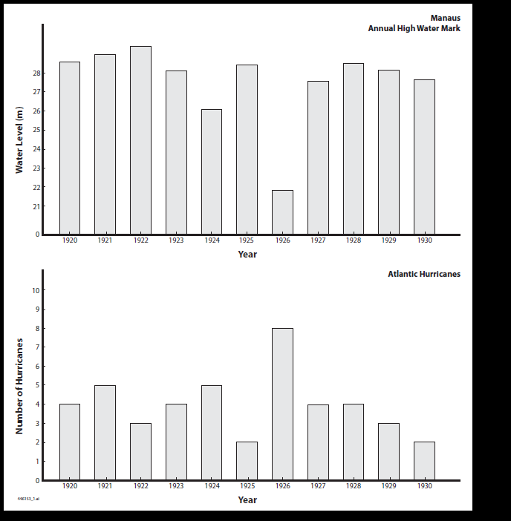
Amazon droughts and Atlantic hurricanes (1920s)

Slide 23
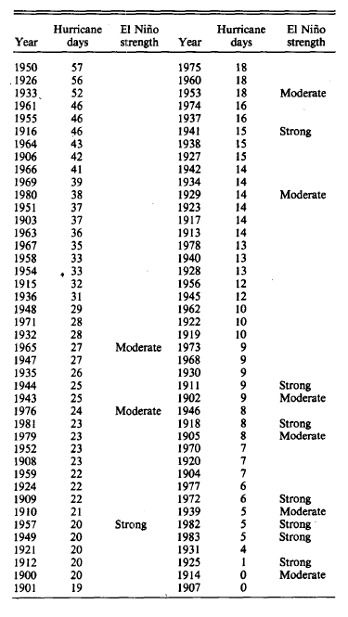
Ranking of seasonal hurricane days, following Gray (Mon. Wea. Rev., 1984)

Slide 24
Atlantic hurricane days by season (1851-2010)
Dry season minima
at Manaus
1950
1995
1926
1933
2005
1961
1998
1906
1916
2010
Manaus Record Begins

Slide 25
Dry season water levels
1995
1950
1926
1961
2005
1933
1998
1955
2010
1963
1916
1906
1967
Drought
Flood
Annual low water marks (m)

Slide 26
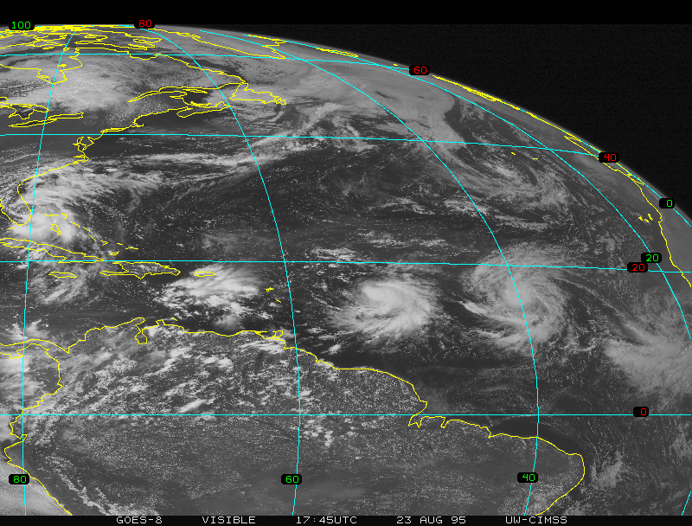
Suppressed convection over Brazil in a strong hurricane season (1995)

Slide 27
Conclusions 1926 remains the most severe Amazon drought in the record from 1903 to present 2010 tied a record for the most severe dry season drought A characteristic feature of the majority of severe droughts is a warm Atlantic Ocean Dry season droughts are coincident with the Atlantic hurricane season A warm Atlantic Ocean favors an active ITCZ An active ITCZ involves stronger subsidence over the Amazon region, and hence greater tendency for drought

Slide 28
Wet season water levels
1926
Drought
Flood
Annual high water marks (m)

Slide 29
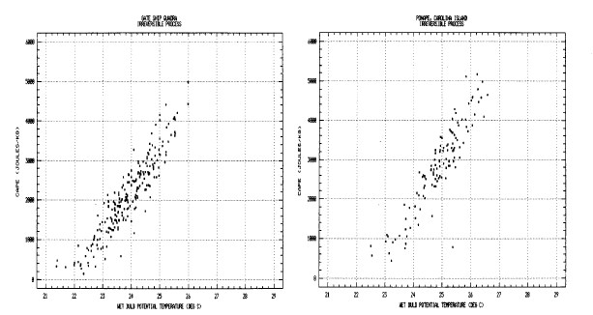
Conditional instability versus wet bulb temperature over oceans in the present climate

Slide 30
Evidence for east-west dipole in dry season rainfall for 2005 Amazon drought

Slide 31
Annual rainfall anomalies for Sao Gabriella da Cachoiera (do Rio Negro)
Rainfall Anomaly (%)
361678_P_25Y.ppt

Slide 32
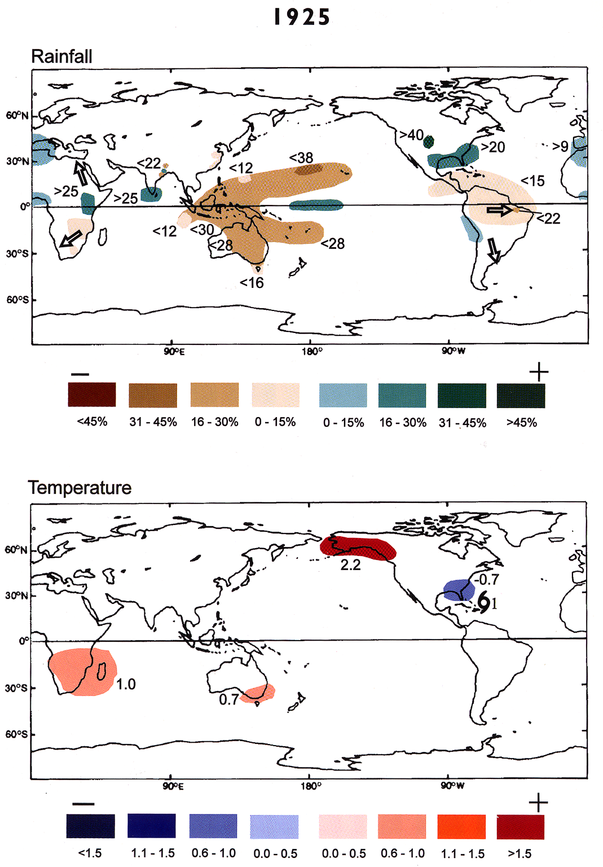
Global Anomalies in 1925 (El Nino year) (from Allan et al. (1996))
361678_P_15Y.ppt

Slide 33
Close up view of Amazon river gauge, showing annual high water marks

Slide 34
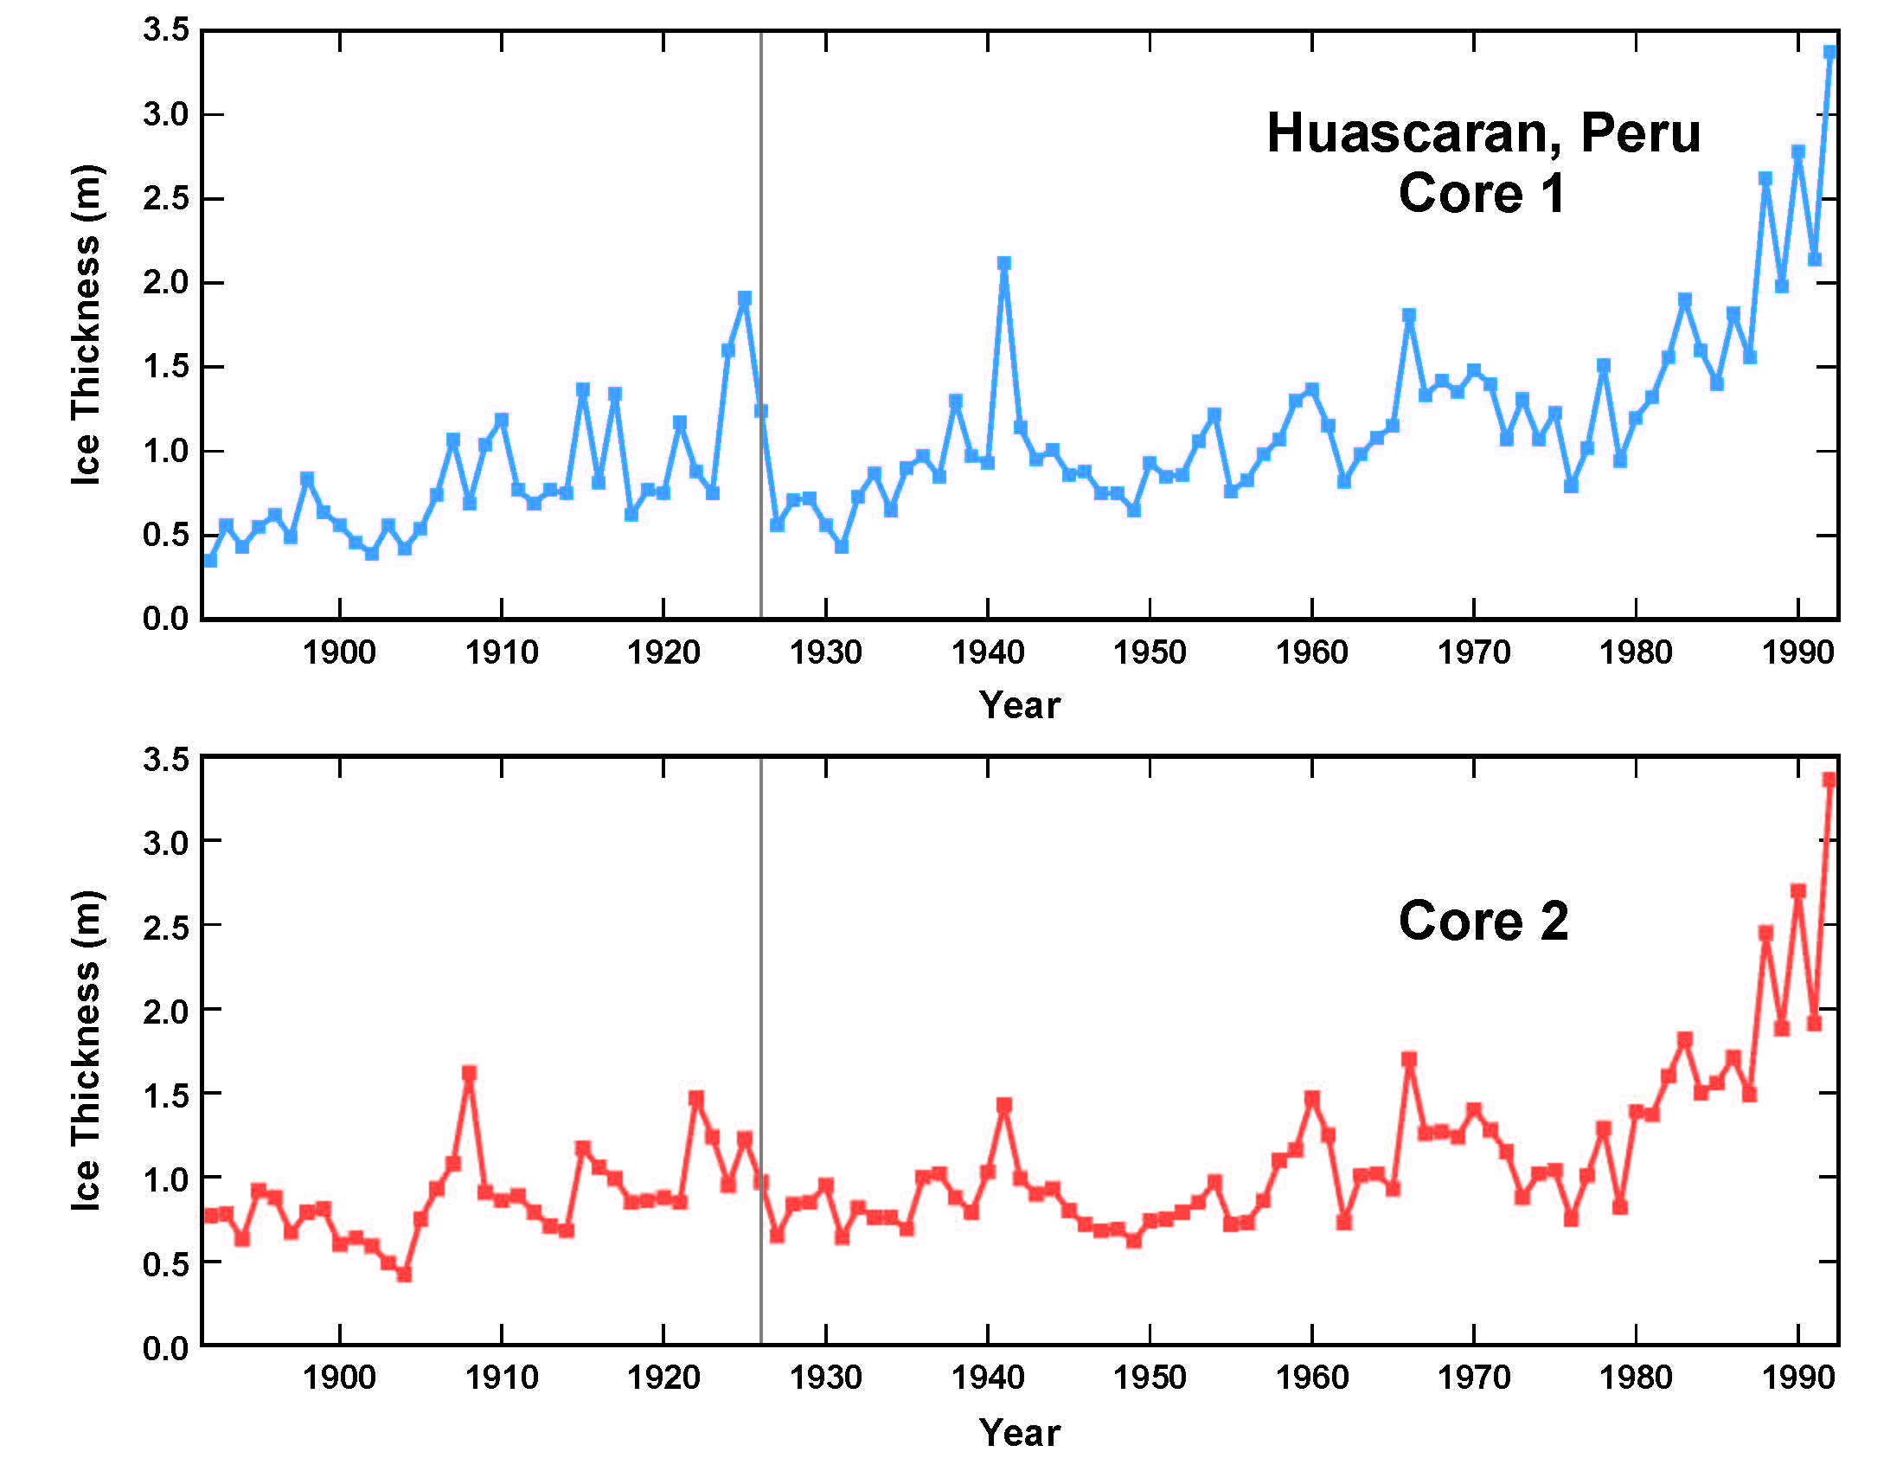
Ice core thicknesses at Huascaran, Peru for 100 years

Slide 35
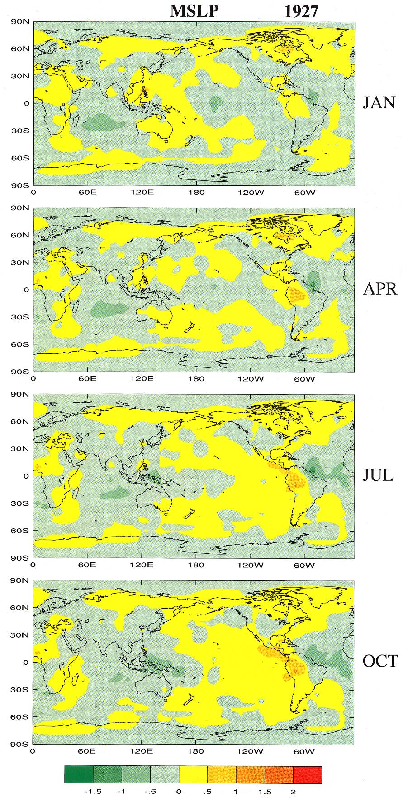
Mean Sea Level Pressure 1927 (from Allan et al. (1996))
361678_P_20Y.ppt

Slide 36
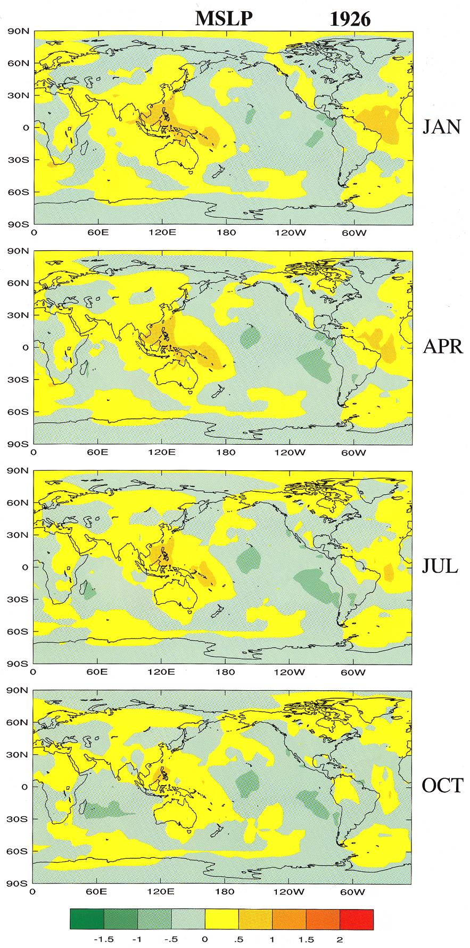
Mean Sea Level Pressure 1926 (from Allan et al. (1996))
361678_P_18Y.ppt

Slide 37
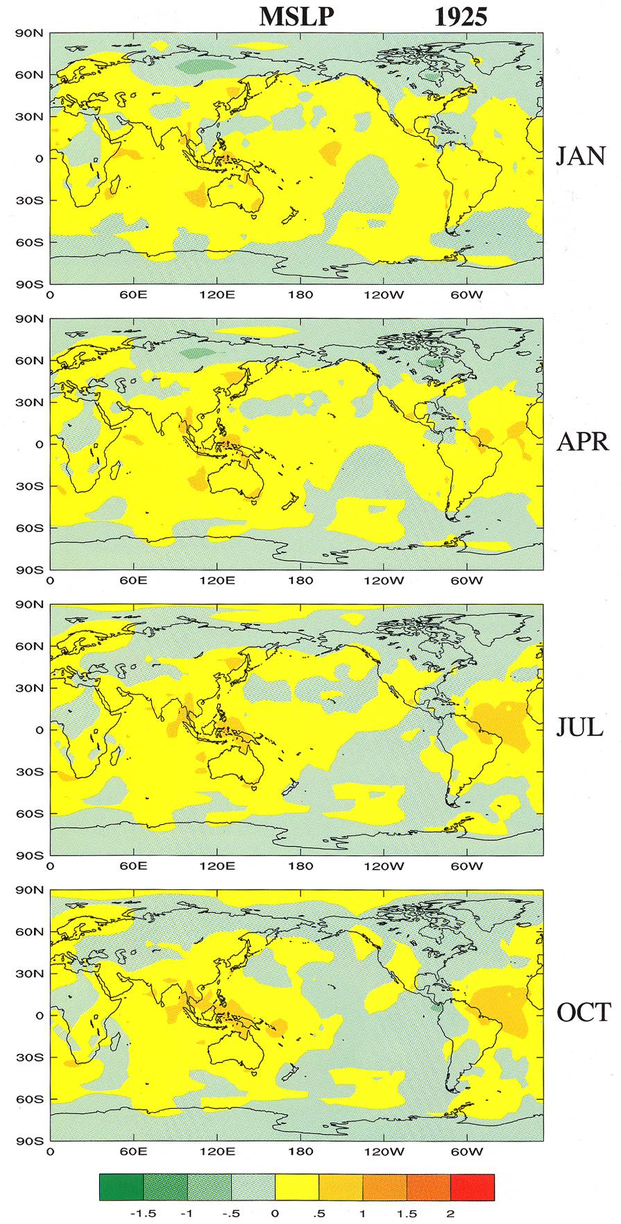
Mean Sea Level Pres1925 (from Allan et al. (1996))
361678_P_16Y.ppt

Slide 38
Venezuela Stations
Rainfall Anomaly (%)
361678_P_1Y.ppt
Williams 06-18-02
361678_P_1Y.ppt
362678_P_1Y.ppt

Slide 39
Rainfall records from Venezuela
Rainfall Anomaly (%)
Rainfall Anomaly (%)
Rainfall Anomaly (%)
Rainfall Anomaly (%)
Rainfall Anomaly (%)
Rainfall Anomaly (%)
Rainfall Anomaly (%)
Rainfall Anomaly (%)
Rainfall Anomaly (%)
Rainfall Anomaly (%)
361678_P_13Y.ppt

Slide 40
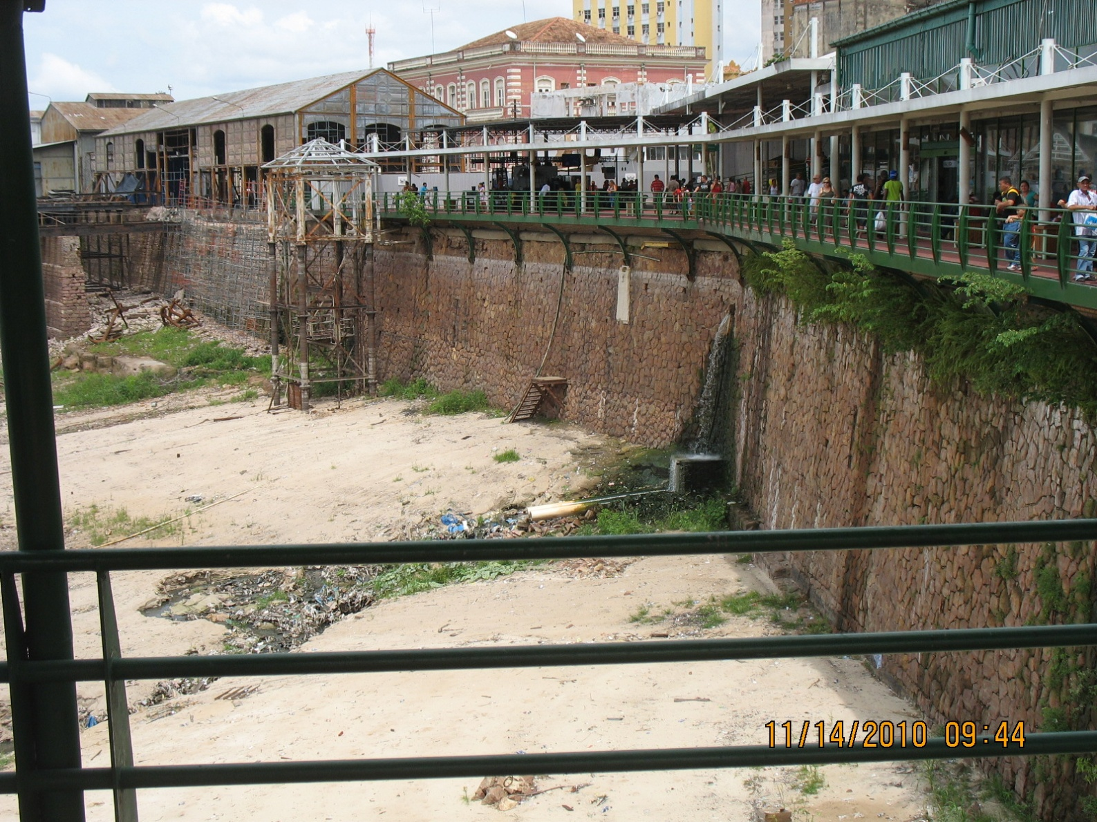
Manaus Harbor and river wall (November, 2010)

Slide 41
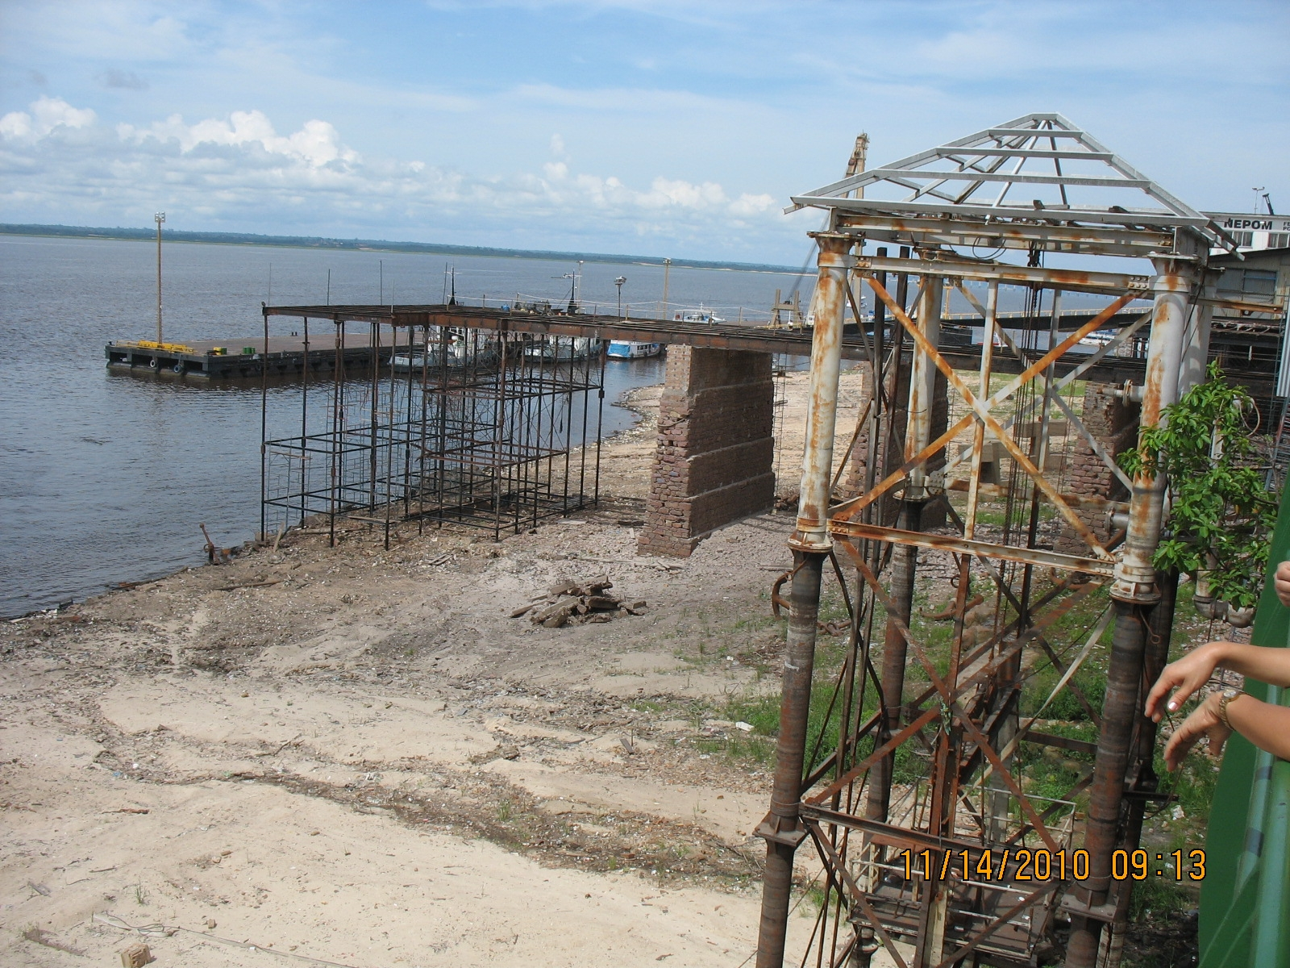
Manaus Harbor, November 2010

Slide 42
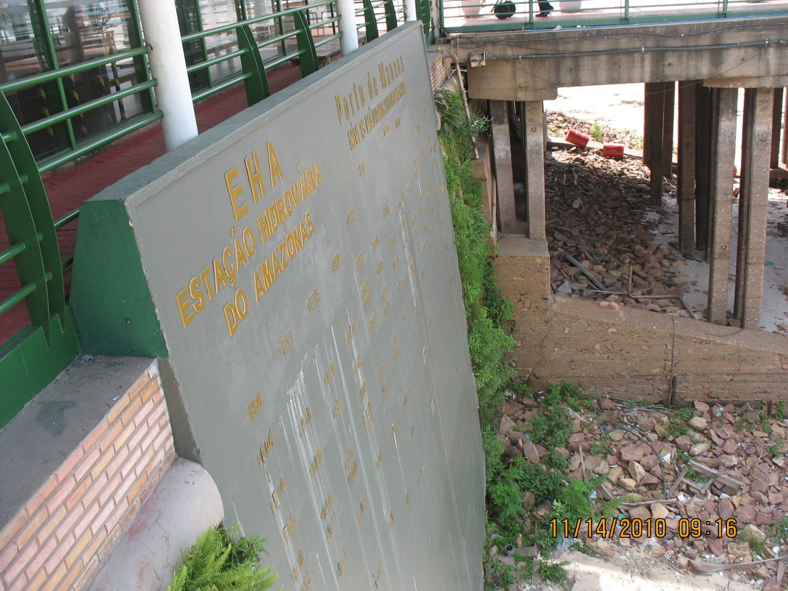
Side view of Amazon river gauge at Manaus, Brazil (November 2010)

Slide 43
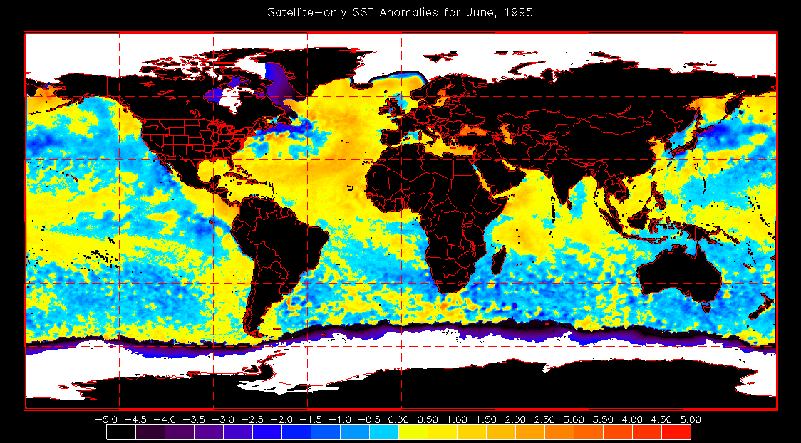
Sea Surface Temperature Anomaly for June 1995

Slide 44
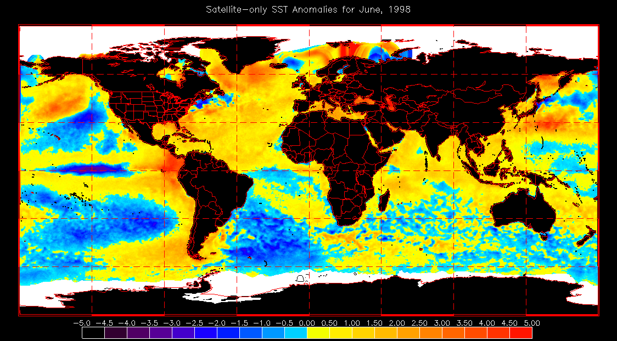
Sea Surface Temperature Anomaly for June 1998

Slide 45
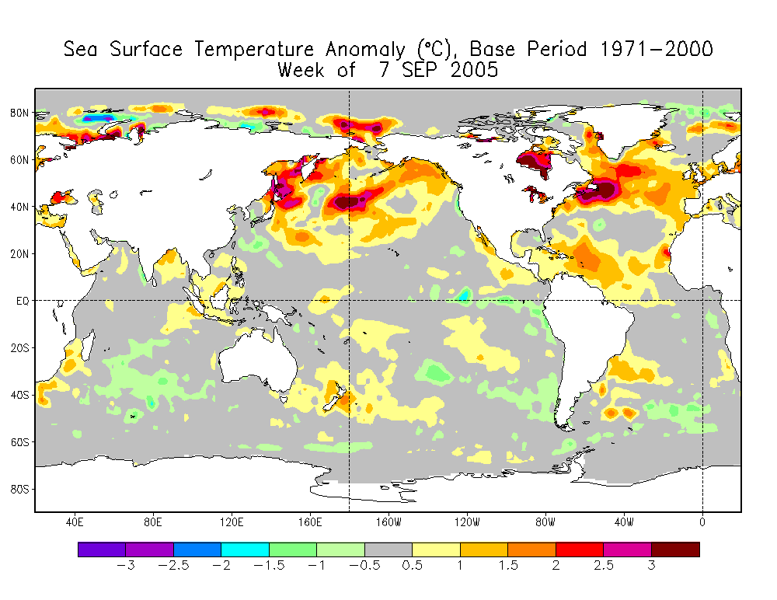
Sea Surface Temperature Anomaly for 7 Sept 2005

Slide 46
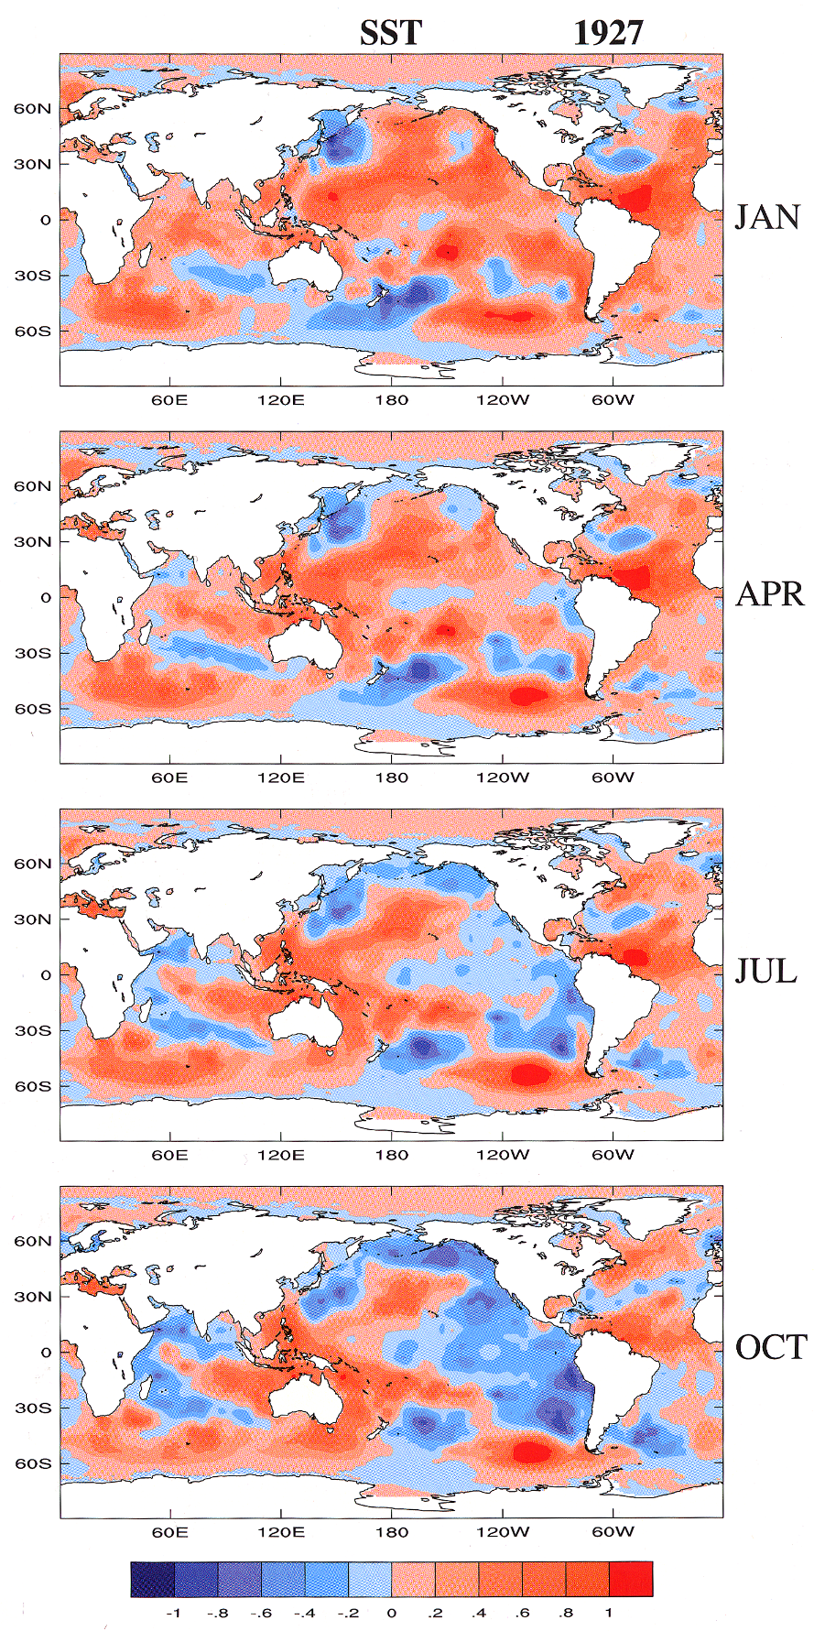
Sea Surface Temperature 1927 (From Allan et al. (1996))
361678_P_21Y.ppt

